Slide 1
You, Me and UV

Slide 2
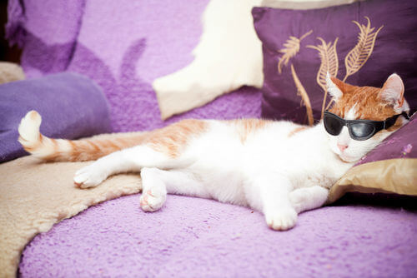
By the end of this Smart Lesson, you should be able to:
1. | Identify where UV falls on the electromagnetic spectrum.
2. | Describe the three groups of UV and how they move through the atmosphere.
3. | Outline the advantages and disadvantages of sun exposure are.
4. | Explain the importance of the UV index.

Slide 3
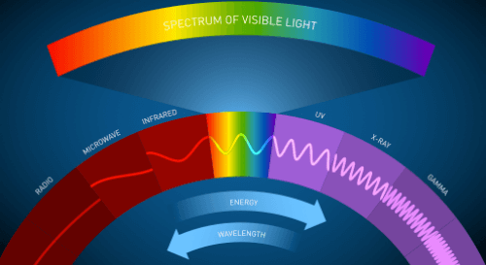
Ultraviolet radiation, also known as UV, falls between x-rays and visible light on the electromagnetic spectrum.
It is produced by very hot objects like the Sun or the specialised bulbs used in tanning beds.
UV travels through the atmosphere along with infrared radiation (felt as heat) and visible light (what we can see); although, only a small amount of UV actually reaches Earth's surface.

Slide 4
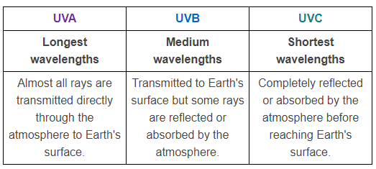
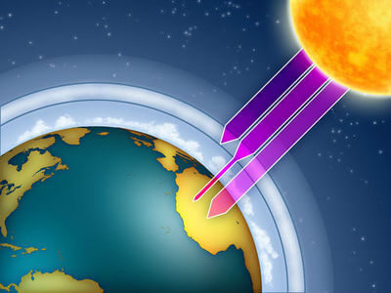
UV can be split into three groups:

Slide 5
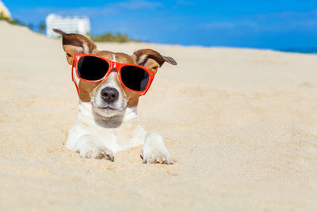
UV is one of the greatest natural sources of vitamin D.
Our bodies need vitamin D to absorb calcium, fight infections and for our bones to grow properly.
We have to spend some time in the sun so that our body can maintain healthy levels of vitamin D.

Slide 6
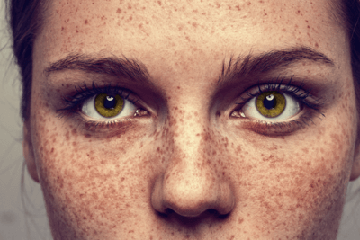
Although we need a certain amount of sun to stay healthy, too much sun can cause serious damage.
Excessive UV exposure can cause sunburn, premature aging, eye damage and skin cancer.
Australia has one of the highest rates of skin cancer in the world. 2 in 3 Australians will have developed some form of skin cancer by age 70.

Slide 7

Melanin is the pigment that determines skin colour.
It also plays an important role in blocking UV from damaging DNA in your skin cells.
UVA activates melanin in the upper skin cells, which causes a quick change in skin colour that doesn't last long. Due to its long wavelengths, UVA can also reach into the deeper skin layers, where it causes wrinkles and gradual loss of elasticity.
UVB causes the production of new melanin, which gradually darkens the skin. UVB is responsible for thickening the outer layer of skin, which is meant to protect the body from further UV damage.

Slide 8
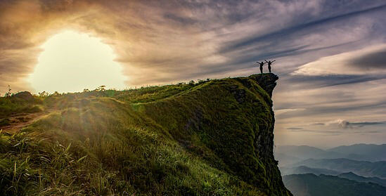
UV exposure has both its advantages and disadvantages.
A balanced approach to spending time in the sun is needed so that we can obtain enough vitamin D without burning and causing skin damage.

Slide 9
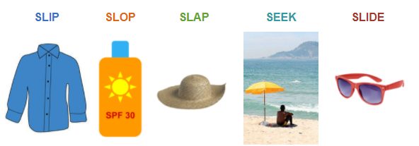
SunSmart is an Australian initiative that teaches the general public about the importance of sun protection and promotes a healthy approach to sun exposure.
Their sun protection slogan is well known.

Slide 10


Slide 11
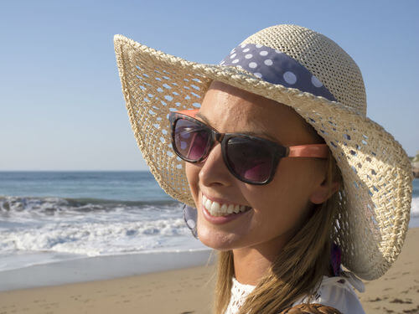
The UV index is a standard way of measuring the strength of UV radiation throughout the day and around the world.
It ranges from 0 (low) through to 11+ (extreme). The UV index varies depending on the time, cloud cover, altitude, latitude, ozone level and ground reflection.
When the UV index is 3 or above, it is recommended that you wear sun protection and find shade when going outside to avoid skin damage.

Slide 12
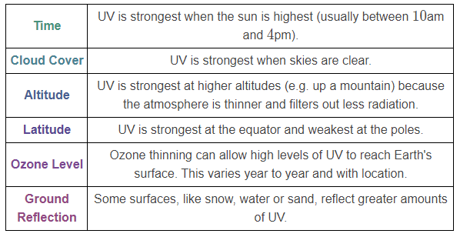
here are many factors that can influence the strength and fluctuation of UV throughout the day.

Slide 13
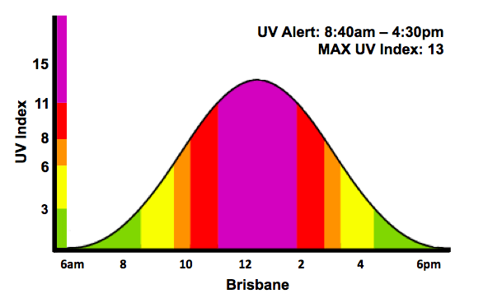
The Bureau of Meteorology provides the Australian public with information about the UV index each day.
You can also find these predictions on the SunSmart app.
Below is an example of what a UV index prediction looks like. The colours represent groups of different UV intensities - green being the lowest UV index, through to purple which represents an extreme UV index.
UV Alert specifies the times during the day when the UV index is above 3 and sun protection is required.

Slide 14
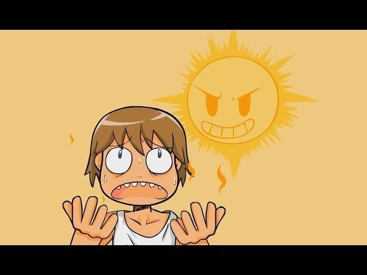

Slide 15
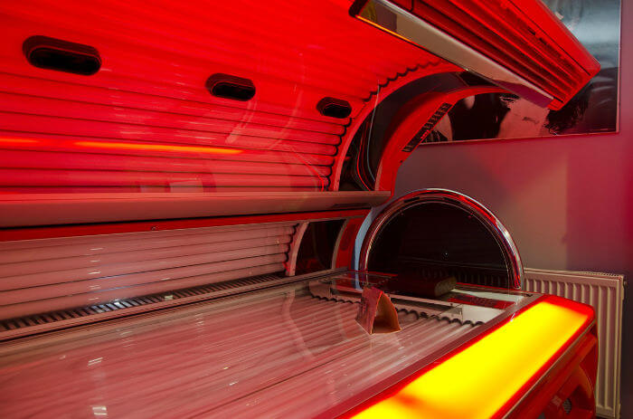
Solariums and tanning beds are artificial sources of UV radiation and are used by people who want to tan their skin.
However, solariums can emit UV at strengths up to 6 times that of the Sun!
Research has shown that people who use solariums before the age of 35 are 59% more likely to develop melanoma than those who don't use solariums.
In 2009, solariums were classified as a carcinogen - a substance that can cause cancer in living tissue. Solariums are now banned throughout most of Australia.

